Slide 1
„Twój StartUp” how it works
Zwoleń 05.12.2013 r.
www.twojstartup.pl

Slide 2
WHAT WE DO:
1. INCUBATION
2. Pre-INCUBATION
www.twojstartup.pl

Slide 3
COMPREHENSIVE SUPPORT
Pre-INCUBATION
E period from business concept to
INCUBATION
The time from standby to record
your own business
readiness for recording your own
business
www.twojstartup.pl

Slide 4
Pre-INCUBATION
Best opportunity for new entrepreneurs
no registration
no long term contract
no risk (responsibility rests on the foundation)
cheep (60 EUR/month)
fast (just 10 minutes)
focus on bussines
www.twojstartup.pl
Notes:
Działanie polegające na identyfikacji innowacyjnych rozwiązań i sprawdzeniu ich potencjału rynkowego.

Slide 5
Pre-INCUBATION
Lending legal personality
EU grants
Bookkeeping
Cooperation with Fundacją
training
Legal advice
Access to the offices of the Foundation
bank account
Access to knowledge
www.twojstartup.pl

Slide 6
INCUBATION
Registration Assistance
EU grants
Bookkeeping
Cooperation with Fundacją
Help in the search for partners
Legal advice
IT advice
tax advice
Virtual office
www.twojstartup.pl

Slide 7
comparison
cost | Self-Employment | Twój StartUp
Registration time | Around 1 week | 10 minutes
Registration cost | 40 EUR | 0 EUR
TAX | 100 – 240 EUR | 0 EUR
Office | 95 EUR | 0 EUR
Bookkeeping | 35 EUR | 0 EUR
Training | 120 EUR | 0 EUR
Legal advice | 60 EUR | 0 zł/2,5 h
Promotion | 120 EUR | 0 zł
SUMA | 570 - 700 EUR | 60 EUR
www.twojstartup.pl

Slide 8
Pre-INCUBATION
benefits
Minimize taxes – 9%,
Possibilities focus on businesses ,
Cash – it’s cheaper.
www.twojstartup.pl

Slide 9
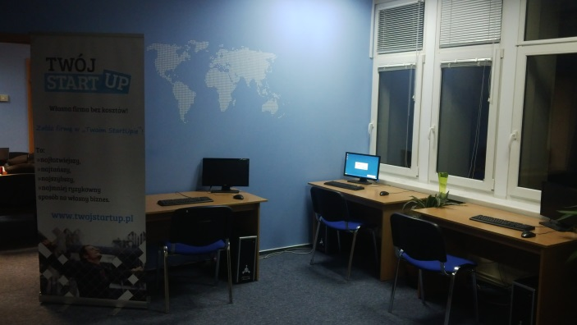
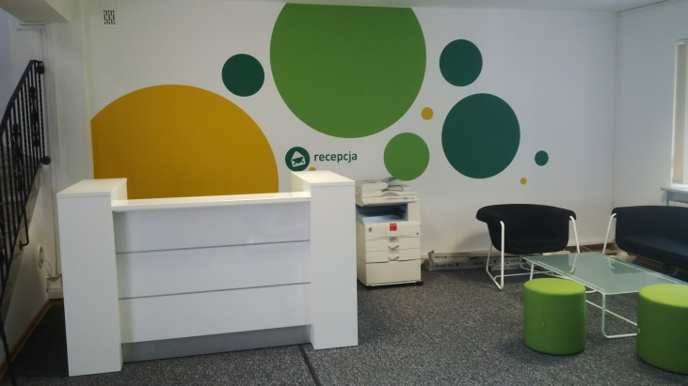
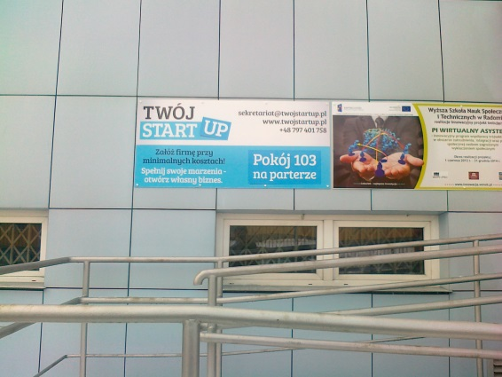
About us…
Actually 20 branch in Poland
More than 300 beneficiaries
Sales beneficiaries exceed tens of thousands of euros per month
Indigenous grants for Beneficiaries exceed 250 000 EUR.
www.twojstartup.pl

Slide 10
Fundation – Contractor - Beneficiaries
How it works?
Fundation
Contractor
Signing of the contract
VAT invoices
Payment of remuneration
Execution of orders
Signing of the contract
Beneficiaries
www.twojstartup.pl

Slide 11
Our Best…

Slide 12
Thank you for your attention!
Kamil Besiński

